Slide 1


INFORMATION SECURITY
Lecture 4
Dr. Muhammad Umar Aftab

Slide 2

LECTURE CONTENTS
Principles of Design and Defense
Employee and Ex-Employee Threats
The Criminal Era Competitor Threats
Cyberwar and Cyberterrorism

Slide 3
Principles of Design and Defense

Slide 4
Fundamental Security Design Principles
The National Centers of Academic Excellence in Information Assurance/Cyber Defense, which is jointly sponsored by the U.S. National Security Agency and the U. S. Department of Homeland Security, list the following as fundamental security design principles [NCAE13]:
  Economy of mechanism: Keep security designs simple and small to minimize vulnerabilities.
  Fail-safe defaults: Deny access by default unless explicitly permitted.
  Complete mediation: Check every access request against security policies without exception.
  Open design: Security should not rely on secrecy of design or implementation.
  Separation of privilege: Require multiple independent conditions for access.

Slide 5
Fundamental Security Design Principles
  Least privilege: Grant only the minimum access rights necessary to perform a task.
  Least common mechanism: Limit sharing of resources to reduce interference and information leaks.
  Psychological acceptability: Design security controls that are easy for users to understand and use.
  Isolation: Separate system components to contain faults and limit damage.
  Encapsulation: Hide internal system details behind well-defined interfaces.
  Modularity: Build systems with interchangeable and independent modules.
  Layering: Use multiple defensive layers to protect against failures.
  Least astonishment: Ensure system behavior matches user expectations to avoid errors.

Slide 6
Security Frameworks and Standards

Slide 7
Security Frameworks and Standards
Cybersecurity standards are published methods to protect users and organizations online.
They cover
  users, networks, devices, software, processes, data (stored or moving), applications, services, and connected systems.

Slide 8
Security Frameworks and Standards
Principal objective:
  reduce risks, including preventing or mitigating cyber-attacks
Published materials include collections of:
  Tools
  Policies
  Security concepts and safeguards
  Guidelines and risk management approaches
  Actions and training
  Best practices, assurance, and technologies

Slide 9
Security Frameworks and Standards
Understanding Cyber-Security Frameworks
  Cybersecurity frameworks consist of comprehensive sets of guidelines, standards, and best practices aimed at managing cyber risks effectively.
These frameworks serve as strategic tools to minimize an organization's vulnerabilities and reduce the chances of exploitation by hackers and cybercriminals.

Slide 10
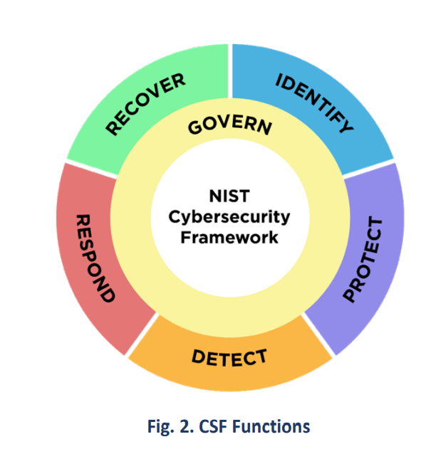
Security Frameworks and Standards: NIST
NIST CSF offers detailed cybersecurity guidance for private sector organizations in the US.
It provides a high-level classification of cybersecurity outcomes and a method to assess and manage them.
Adaptable to organizations of various sizes and cybersecurity maturity levels
The Functions should be addressed concurrently.
  Actions that support GOVERN, IDENTIFY, PROTECT, and DETECT should all happen continuously, and actions that support RESPOND and RECOVER should be ready at all times and happen when cybersecurity incidents occur.
All Functions have vital roles related to cybersecurity incidents.
  GOVERN, IDENTIFY, and PROTECT outcomes help prevent and prepare for incidents, while GOVERN, DETECT, RESPOND, and RECOVER outcomes help discover and manage incidents.
https://www.nist.gov/cyberframework
Notes:
NIST CSF (National Institute of Standards and Technology Cybersecurity Framework)

Slide 11
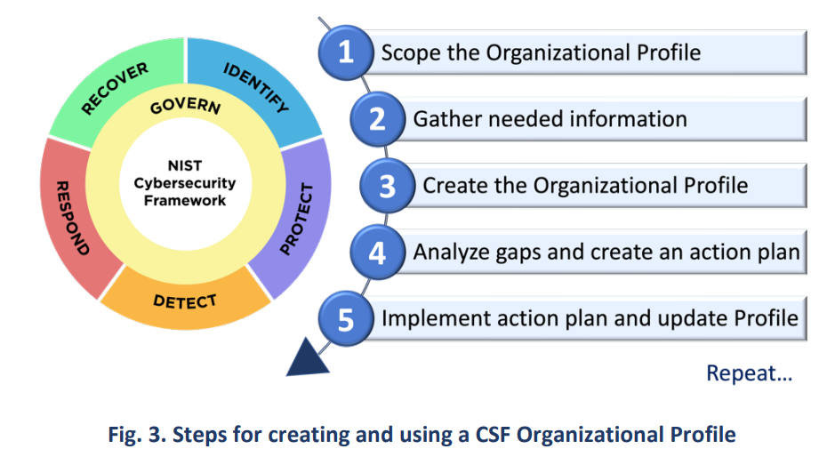
Security Frameworks and Standards: NIST
https://www.nist.gov/cyberframework

Slide 12
ISO/IEC 27001
ISO/IEC 27001, part of the ISO/IEC 27000 series/family, which is an Information security management system (ISMS) standard.
The latest version was published in October 2013 by ISO and IEC.
Its full title is=> ISO/IEC 27001:2013 – Information technology – Security techniques – Information security management systems – Requirements.
ISO/IEC formally specifies a management system to control information security explicitly.

Slide 13
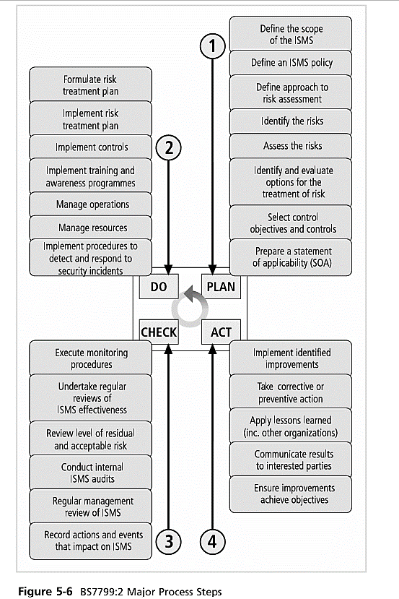
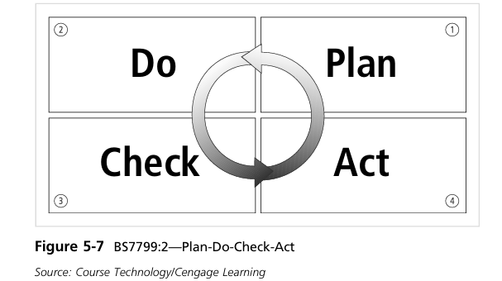
ISO 27001
Reference book: Principles of Information Security

Slide 14
GDPR Overview
The General Data Protection Regulation (GDPR) is a comprehensive legal framework established by the European Union to safeguard the privacy and security of personal data belonging to its residents.
Introduced in 2016, this regulation applies to any organization that handles the personal information of EU citizens, no matter where the organization is based globally.

Slide 15
GDPR Compliance checklist
Data Mapping: Document what personal data is collected, why, and how it’s processed/stored.
Legal Basis: Identify the lawful reason for each data processing activity.
Policies: Create clear, plain-language privacy policies and consent forms.
Training: Educate staff on GDPR and data protection basics.
Third-Party Management: Ensure vendors follow GDPR and have proper contracts.
Audits: Regularly review compliance and fix gaps.

Slide 16
GDPR Compliance checklist
DPO: Appoint a Data Protection Officer if required.
DPIAs: Assess risks for high-impact data projects.
Security Measures: Use encryption, MFA, and regular security checks.
Data Rights: Enable access, correction, deletion, and objection.
Breach Response: Have a plan to detect and report data breaches fast.

Slide 17
Center for Internet Security (CIS)
A prioritized set of cybersecurity best practices.
Originally known as SANS Top 20; now managed by CIS.
Globally recognized for reducing risk from common threats.
Suitable for organizations of all sizes and sectors.

Slide 18
Structure of CIS Controls
1. Basic Controls (CIS 1–5)
  Establish core cybersecurity hygiene.
  CIS 1: Inventory of hardware assets
  CIS 2: Inventory of software assets
  CIS 3: Data protection (encryption, DLP)
  CIS 4: Secure configuration of systems
  CIS 5: Account lifecycle management
2. Foundational Controls (CIS 6–10)
  Strengthen defenses and monitoring.
  CIS 6: Access control (least privilege)
  CIS 7: Continuous vulnerability management
  CIS 8: Audit log collection and analysis
  CIS 9: Email & browser protections
  CIS 10: Malware defenses

Slide 19
Structure of CIS Controls
3. Organizational Controls (CIS 11–15)
  Embed security into governance and culture.
  CIS 11: Data recovery capabilities
  CIS 12: Secure network infrastructure
  CIS 13: Security awareness training
  CIS 14: Secure software development
  CIS 15: Third-party/service provider management
Why Use CIS Controls?
  Actionable, prioritized, and cost-effective
  Protects against real-world threats
  Useful for both new and mature security programs
  Supports compliance and risk management
Notes:
To Provide a Common Framework and Language
To Establish a Baseline of Best Practices
To Guide Risk Management
To Promote a Proactive, Holistic Approach

Slide 20
Employee and Ex-Employee Threats
Employees and ex-employees are a major source of computer crimes
Many perpetrators had legitimate or recent access to systems
Managing personnel with access is a critical security priority
Notes:
a person who carries out a harmful, illegal, or immoral act (perpetrators)

Slide 21
Types of Employee Threats
Unintentional
  Forgetting security rules
  Failing to follow procedures
  Creating vulnerabilities unknowingly
Intentional
  Knowingly violating controls
  Assisting in security breaches

Slide 22
Examples of Internal Threats
Unauthorized access or enabling others
Altering or deleting data
Crashing or destroying systems
Misusing systems for personal gain
Holding data hostage
Stealing customer/strategic data (espionage, fraud)
Notes:
“Holding data hostage" refers to a cyberattack where a criminal gains access to a person's or organization's data and denies them access to it, often by encrypting the files.

Slide 23
Background Checks & Screening
Resume verification (employment & education history)
Interview discrepancies with experienced staff
Intensive checks for sensitive roles:
  Background investigation agency
  Criminal record check
  Credit record check (financial stress risks)
  Polygraph (where legal)
  Bonding for sensitive positions
Notes:
A polygraph, or "lie detector," measures a person's physiological responses, such as blood pressure, pulse, respiration, and skin conductivity, while they answer a series of questions.

Slide 24
Employment Agreements
Contracts should include:
  Confidentiality & non-disclosure agreements
  Employee obligations to protect information
  Reference to organization’s security policy
Employees must review and agree to abide by policy

Slide 25
Security During Employment
Ongoing awareness and training programs
Policies for email & Internet use (Examples of NUCES)
Key principles:
  Least privilege – minimal access required
  Separation of duties – avoid conflicts of interest
  Avoid over-reliance on key employees → build redundancy

Slide 26
Termination of Employment
ISO 27002 Objective: Orderly exit & removal of access
Key actions:
  Remove from access lists
  Inform guards/security teams
  Revoke personal access codes/cards
  Change locks/reprogram systems
  Recover company assets (IDs, devices, documents)
  Notify relevant departments

Slide 27
Conclusion
Employees and ex-employees can be significant threats
Security measures must cover:
Hiring → Employment → Termination
Strong personnel security reduces risks of:
  Insider misuse
  Espionage
  Fraud and sabotage
Notes:
Cyber espionage is the act of gaining unauthorized access to sensitive or classified information through computer networks.
In cybersecurity, sabotage is the deliberate action to damage, disrupt, or destroy an organization's IT infrastructure, data, or systems to achieve a specific goal.
Reference
Book 1: COMPUTER SECURITY PRINCIPLES AND PRACTICE Fourth Edition William Stallings Lawrie Brown
Page : 1375
Book 2: COMPUTER SECURITY PRINCIPLES AND PRACTICE Second Edition William Stallings Lawrie Brown
page: 571

Slide 28
The Criminal Era Competitor Threats
Corporate Espionage & Cybersecurity Risks
Businesses face threats not only from hackers but also from competitors
Competitors may use unethical or illegal tactics to gain advantage
Known as corporate espionage or industrial spying

Slide 29
Nature of Competitor Threats
Theft of trade secrets and intellectual property
Unauthorized access to confidential business data
Manipulation of systems to cause financial or reputational harm
Targeting strategic assets (customers, designs, formulas)

Slide 30
Common Techniques
Hacking into rival networks
Planting insiders or bribing employees
Stealing customer or supplier databases
Reverse engineering of products
Spreading misinformation or fake news

Slide 31
Motivations of Competitor Threats
Gaining market advantage
Disrupting rival operations
Copying innovations without R&D costs
Winning contracts through stolen insights

Slide 32
Real-World Examples
Cases of corporate espionage lawsuits across industries
Technology, pharmaceutical, and defense industries are prime targets
State-sponsored competitors may also engage in cyber-theft
Examples
  Coca-Cola vs. Pepsi (2006): Pepsi employees caught attempting to steal Coke’s trade secrets.
  Google vs. Uber (2017): Lawsuit over stolen self-driving car technology.
  DuPont (2011): Chinese company convicted of stealing chemical formula for Kevlar.
Notes:
Lawsuit-> filed Case

Slide 33
Consequences for Victims
Financial losses (millions to billions)
Loss of customer trust and loyalty
Competitive disadvantage in the market
Legal and regulatory consequences

Slide 34
Defense Strategies
Strong cybersecurity policies & monitoring
Employee awareness and training (reduce insider risk)
Use of encryption & secure communication
Regular audits and access control reviews
Legal action & collaboration with authorities

Slide 35
ISO 27002 Perspective
Security objectives:
Protect intellectual property
Prevent misuse of sensitive information
Ensure confidentiality, integrity, availability of corporate data

Slide 36
Conclusion
Competitor threats are part of the “criminal era” of cyber risks
Organizations must defend against both external attackers and corporate spies
A proactive security culture is essential to safeguard competitive edge

Slide 37
Cyberwar and Cyberterrorism
Cyberwar the use of computer technology to disrupt the activities of a state or organization, especially the deliberate attacking of information systems for strategic or military purposes.
Cyberterrorism involves hacking to conduct terrorist activities via networks or the Internet.
Governments worldwide are working to secure:
  Critical computing systems
  Communication networks
  Physical and power infrastructures
Notes:
Principles of Information Security Fourth Edition
Page: 96

Slide 38
Cyberwar and Cyberterrorism
Origin of the Term
  Coined in the 1980s by Barry Collin (Institute for Security and Intelligence, California).
  Defined as the convergence of cyberspace + terrorism.

Slide 39
FBI Definition
Mark Pollitt (FBI) defines cyberterrorism as:
  Premeditated, politically motivated attacks
  Target: information, computer systems, programs, and data
  Results in violence against noncombatant targets
  Carried out by subnational groups or clandestine agents
Notes:
Clandestine: kept secret or done secretively

Slide 40
Early Instances
Example: Defacement of NATO websites during the Kosovo War (1998-1999).
Some experts considered cyberterrorism as hype that distracts from pressing cybersecurity issues.

Slide 41
Notable Attack (2002)
Oct 21, 2002:
  A Distributed Denial-of-Service (DDoS) attack targeted the 13 root DNS servers.
  9 out of 13 servers jammed.
Problem mitigated quickly; most Internet users unaffected.
Notes:
DDoS attack targeted all 13 root DNS servers on October 21, 2002. The attack lasted for about an hour, sending large amounts of malicious traffic to the servers, which resulted in some performance degradation but did not cause a complete outage.

Slide 42
Impact of the Attack
At peak, only 6% of DNS requests went unanswered.
Normally, DNS responds almost 100% of the time.
While limited, the attack showed the potential scale of cyberterrorism threats.
Conclusion
  Cyberterrorism poses risks to national security and critical infrastructure.
  Even small disruptions highlight vulnerabilities in global systems.
  Continuous improvement in cyber defense strategies is essential.

Slide 43
References
Principles of Information Security Fourth Edition
COMPUTER SECURITY PRINCIPLES AND PRACTICE Second Edition William Stallings Lawrie
COMPUTER SECURITY PRINCIPLES AND PRACTICE Fourth Edition William Stallings
ISO/IEC 27002:2022 – Information Security Controls.
Kshetri, N. (2019). 1. Cybersecurity and International Relations.
MIT Press.U.S. Department of Justice – Economic Espionage Act (1996).
BBC News (2006). “Pepsi employee offered Coke secrets.”
Reuters (2017). “Google’s Waymo settles with Uber in trade secrets lawsuit.”
FBI (2020). Corporate Espionage Threats and Prevention.

Slide 44
References
https://nvlpubs.nist.gov/nistpubs/CSWP/NIST.CSWP.29.pdf
https://www.scribd.com/document/900236879/Cybersecurity-Frameworks-and-Standards-1720047371
https://www.nist.gov/cyberframework
https://www.attackiq.com/wp-content/uploads/2021/02/cisos-guide-to-the-top-cybersecurity-frameworks.pdf
https://sprinto.com/blog/iso-27001-risk-management-policy/
Principles of Information Security (Fourth Edition)
COMPUTER SECURITY PRINCIPLES AND PRACTICE Second Edition

Slide 45


